Slide 1

HIEM Energy LLP
STRATEGIC ENERGY MANAGEMENT PLAN – SEMP
PROPOSAL
Prepared for: HIEM Energy LLP
Based in Canada, British Columbia

Slide 2
WHO WE ARE
Energy Management consulting firm with a combined 11 years of experience in the industry
Commercial, Industrial and Residential Portfolio
In house process to gather a situational analysis, equipment inventory, Six-Sigma Journey and energy audits will further your journey into Emissions reductions
10% reduction is easily done, anything over 10% would be staged over 5-10 years at increments of 10% a year respectively, pending on your timeline and how aggressive you would like to be

Slide 3
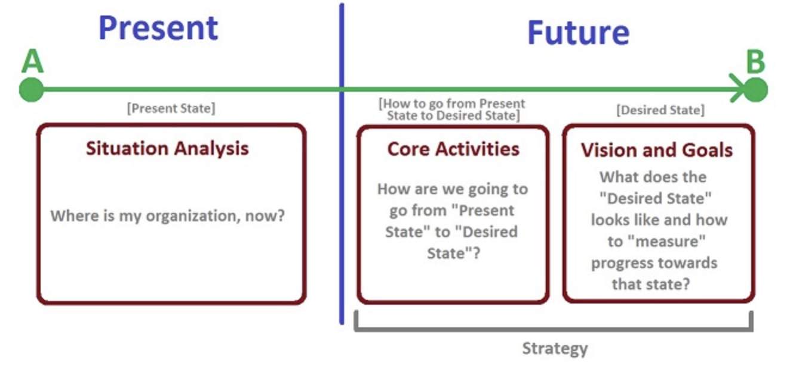
SITUATIONAL ANAYLSIS

Slide 4
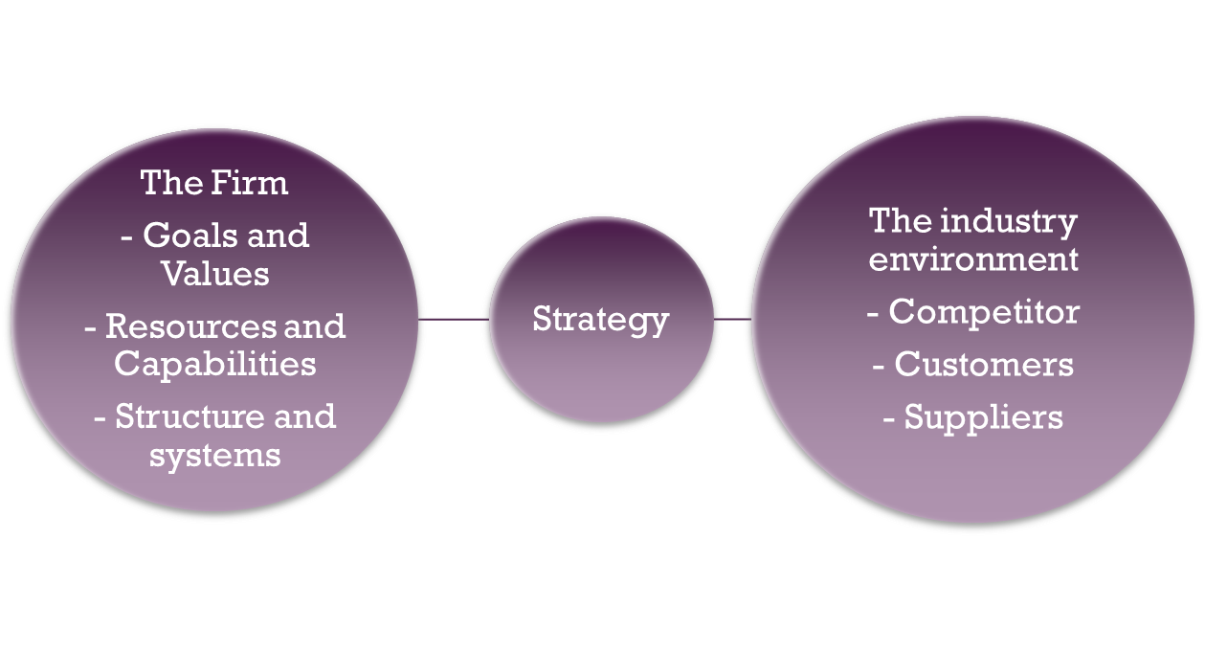
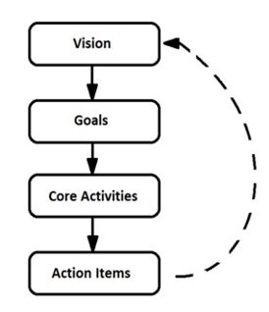
Strategy – Special Purpose Vehicle

Slide 5
Examples of Questions Asked
Internal
GHG Emissions / Current Energy Use
Overall GHG reductions Target
COO’s vision / Executive team Vision
Has an Energy Audit been conducted? If so, what did it show?
What is the budget for energy management?
What should be the duration of the strategic energy management plan, 3 years, 5 years, 10 years?
External
What is the role of the Energy Manager?
What are your competitors doing differently?
What do the customers want, and what is it that they value?

Slide 6
Internal and External Goals
Define Internal Goals
30% reduction in energy consumption.
Improve Employee Morale
Reduce downtime
External Goals
Improve Customer Satisfaction Rates
Lowering Environmental Impact
Measure
HIEM Energy will effectively collect and identify the laws and regulations on energy conservation (like the Energy Star)

Slide 7
Internal and External Goals
Analyze
Systematic analysis of meter data, overall consumption, process equipment energy use and employer/employee impacts.
Improve the process
Promote the implementation of the energy management system and check it regularly; verify whether the activities of each department meet the requirements of the system, if not rectification in time;
Control
Applying for a third-party audit after internal audit problem rectification and management review. For problems that cannot be rectified in the short term, long-term tracking verification should be carried out, and the whole energy management system should follow the cyclic process.
Report
Different tools

Slide 8
Risks Management
HIEM will create a risk-based mindset at your workplace and develop the SEMP includes a risk management system.
Potential Issues:
1.Competing objectives
2.Pressure to perform in the first year
3.Pressure for year over year performance
4.Competing expectations

Slide 9
SEMP Approach and Methodology
Understand the different perspectives across the organization
Receive direction from the corporate level
Receive direction from the departmental level
Encourage cross functional team to accomplish all goals, objectives
Encourage everyone in the Organization to ‘Think strategically’
Competing objectives & expectations
Pressure to perform in the first year
Pressure for year over year performance
2-3 initial meetings with Board of Directors, to create and align a plan with visions and goals

Slide 10
Reporting (Internal & External)
Internal reporting of energy savings: Establish a solid baseline, measure success of current initiatives, and celebrate success based on sound analysis and solid numbers
Measurement and Verification (M&V): Using measurement to determine actual savings created by an energy conservation measure
Monitoring, Targeting and Reporting (MT&R): Provide feedback on operating practices, results of energy management projects, and guidance on the level of energy use that is expected in a certain period
External reporting and internal reporting tools: Such as, the Energy Star Portfolio Manager, CUSUM -Absolute & Normalizing

Slide 11
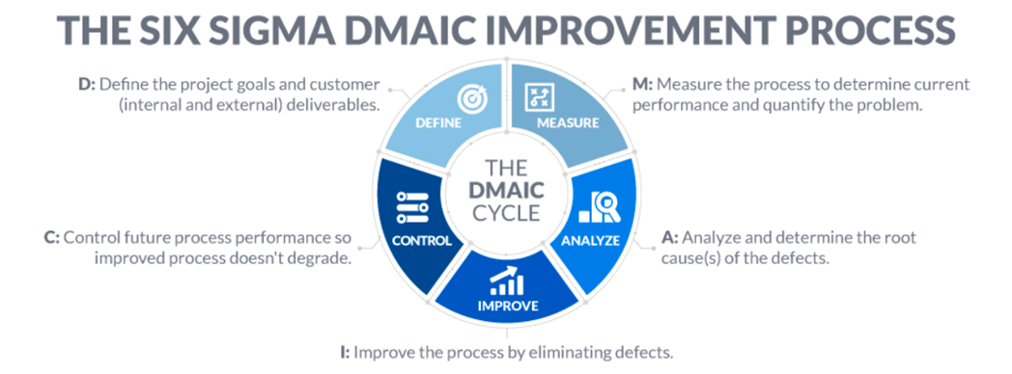
Strategic Plan Discussion
Six Sigma

Slide 12
Six Sigma
Approach
Demonstrated commitment to Six Sigma Journey by implementing it at the highest levels of management.
Trained more than 10,000 employees and all levels of Management in the roles of Six Sigma
Reduction of $billion in production waste
Data Driven problem-solving process, to devise solutions to waste issues in the die casting, extrusion, and machining process.

Slide 13
Conclusions
Energy Management Plan for Clients
Powerful vision, that is imaginable, desirable, feasible, focused, flexible and communicable
Situation analysis to identify improvements areas, lead to reduced energy consumption, create a competitive advantage through energy efficiency, and to confirm the legal obligations
Use soft goals, energy reduction goals, surveys to quantify and measure if a vision has been realized
Transform goals & values, resources & capabilities, structure & systems into a lucrative industrial environment sustains industry competition

Slide 14
Conclusions
Energy Management Plan for Clients
Assess the fit between your strategy and organization, to make sure that, the implementation of the strategic plan will NOT fail, if both human and financial resources are matched
‘Present State’ and ‘Future Goals’ will be attained, leading to a Strategy and Plan to attain your Vision
The Energy Management approach giving Clients
SMART goals (Specific, Measurable, Attainable, Realistic, Time bound)

Slide 15
Energy Project’s Team
HIEM Energy Team will show in the proposal

Slide 16
Project Plan Schedule
The SEMP proposal will include:
Project Schedule
Gantt Chart
Team Deployment Position

Slide 17
Contact Us
The SEMP proposal will include:
Email : info@hiemenergy.com
Canada, Burnaby , BC

